Slide 1
Planning Your Financial Future
Lesson 21

Slide 2
A World of Risk
Slide 21.1
Lesson 21 – Planning Your Financial Future
Risk of principal: The risk that some or all of the original deposit or investment may be lost.
Market risk: The risk that the forces of supply and demand or unforeseen events may affect the value of an investment.
Interest-rate risk: The risk that interest rates will change. An investor, for example, might hold a fixed-rate investment, such as a bond. If the bond holder decides to sell the bond before maturity and market interest rates are higher than what the bond is earning, the price of the bond will be lower.
Inflation risk: The risk that the return on an investment will not keep pace with inflation, and the saver’s purchasing power will fall.

Slide 3
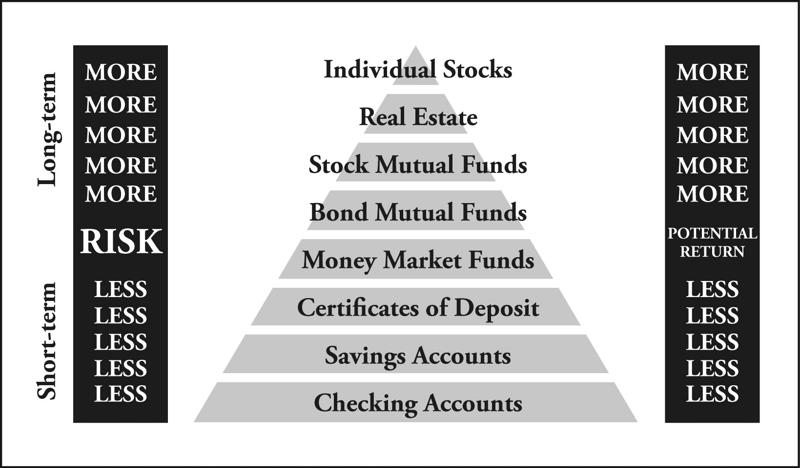
Risk Pyramid
Slide 21.2
Lesson 21 – Planning Your Financial Future

Slide 4
Elements of a Financial Plan
Slide 21.3
Lesson 21 – Planning Your Financial Future
Financial goals
Net worth statement
Income and expense statement
Insurance plan
Saving and investment plan

Slide 5
Important Things to Know about Your Clients
Slide 21.4
Lesson 21 – Planning Your Financial Future
How much does the client have in savings?
Is the client able to save some money each month without borrowing?
Is the client responsible for people who are financially dependent?
How much risk is the client willing to take in order to pursue a higher rate of return?
How close is the client to retirement?
Does the client expect his or her savings to generate current income?
Is the client primarily hoping for growth?
Would the client benefit from tax-deferred or tax-exempt investments?

