Slide 1
The Role of Government in Financial Markets
Lesson 15

Slide 2
Financial Market Problems
Slide 15.1
Lesson 15 – The Role of Government in Financial Markets
Financial markets may fail.
Government regulation is aimed at preventing market failure.
Regulation is itself subject to government failure.
Some investors’ losses result from business decisions that did not work out (no market failure and no government failure).

Slide 3
The SEC and Market Failure
Slide 15.2
Lesson 15 – The Role of Government in Financial Markets
The Securities and Exchange Commission (SEC) is a federal agency authorized to enforce securities laws and issue regulations aimed at three problems:
Dishonest statements from companies offering stocks.
SEC role: reporting and disclosure requirements.
2. Unfair treatment of investors.
SEC role: rules and monitoring of trading.
3. Outright fraud and theft of investors’ funds.
SEC role: enforcement actions, lawsuits.

Slide 4
Government Failure
Slide 15.3
Lesson 15 – The Role of Government in Financial Markets
Like markets, government policies and programs may fail.
The Federal Reserve System failed to prevent bank failures in the 1930s.
In 2008, the SEC failed to identify and take action against a totally fraudulent investment scheme run by Bernard Madoff, in which investors lost billions of dollars.

Slide 5
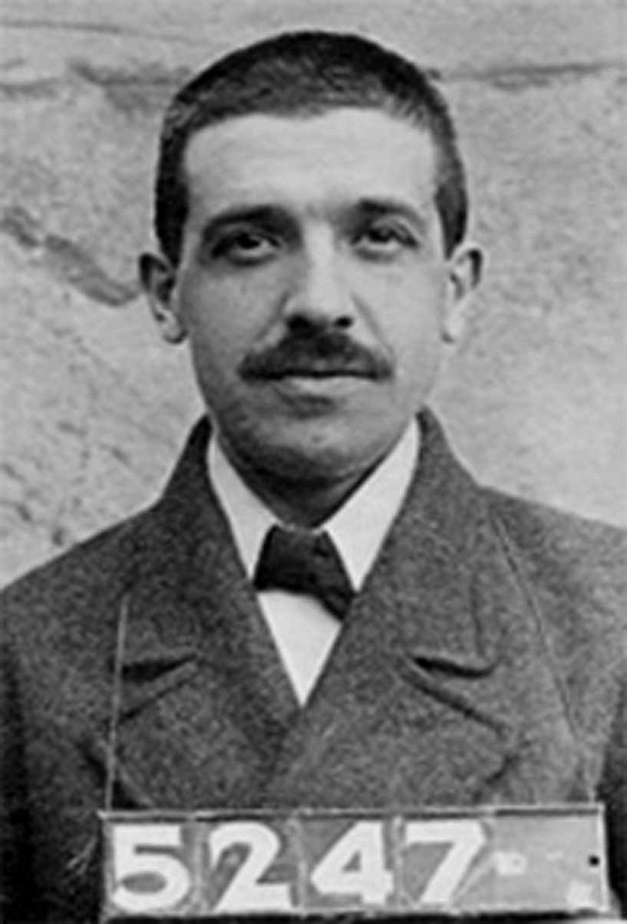
What is a Ponzi Scheme?
Slide 15.4
Lesson 15 – The Role of Government in Financial Markets
Named after Charles Ponzi, who was born in Italy but became a swindler in North America.
Ponzi schemes operate with no real profits or assets.
Investors are recruited with promises of high gains.
Early investors are paid with money collected from later investors.
Eventually such a scheme collapses since no real profits or assets exist to sustain it.

Slide 6
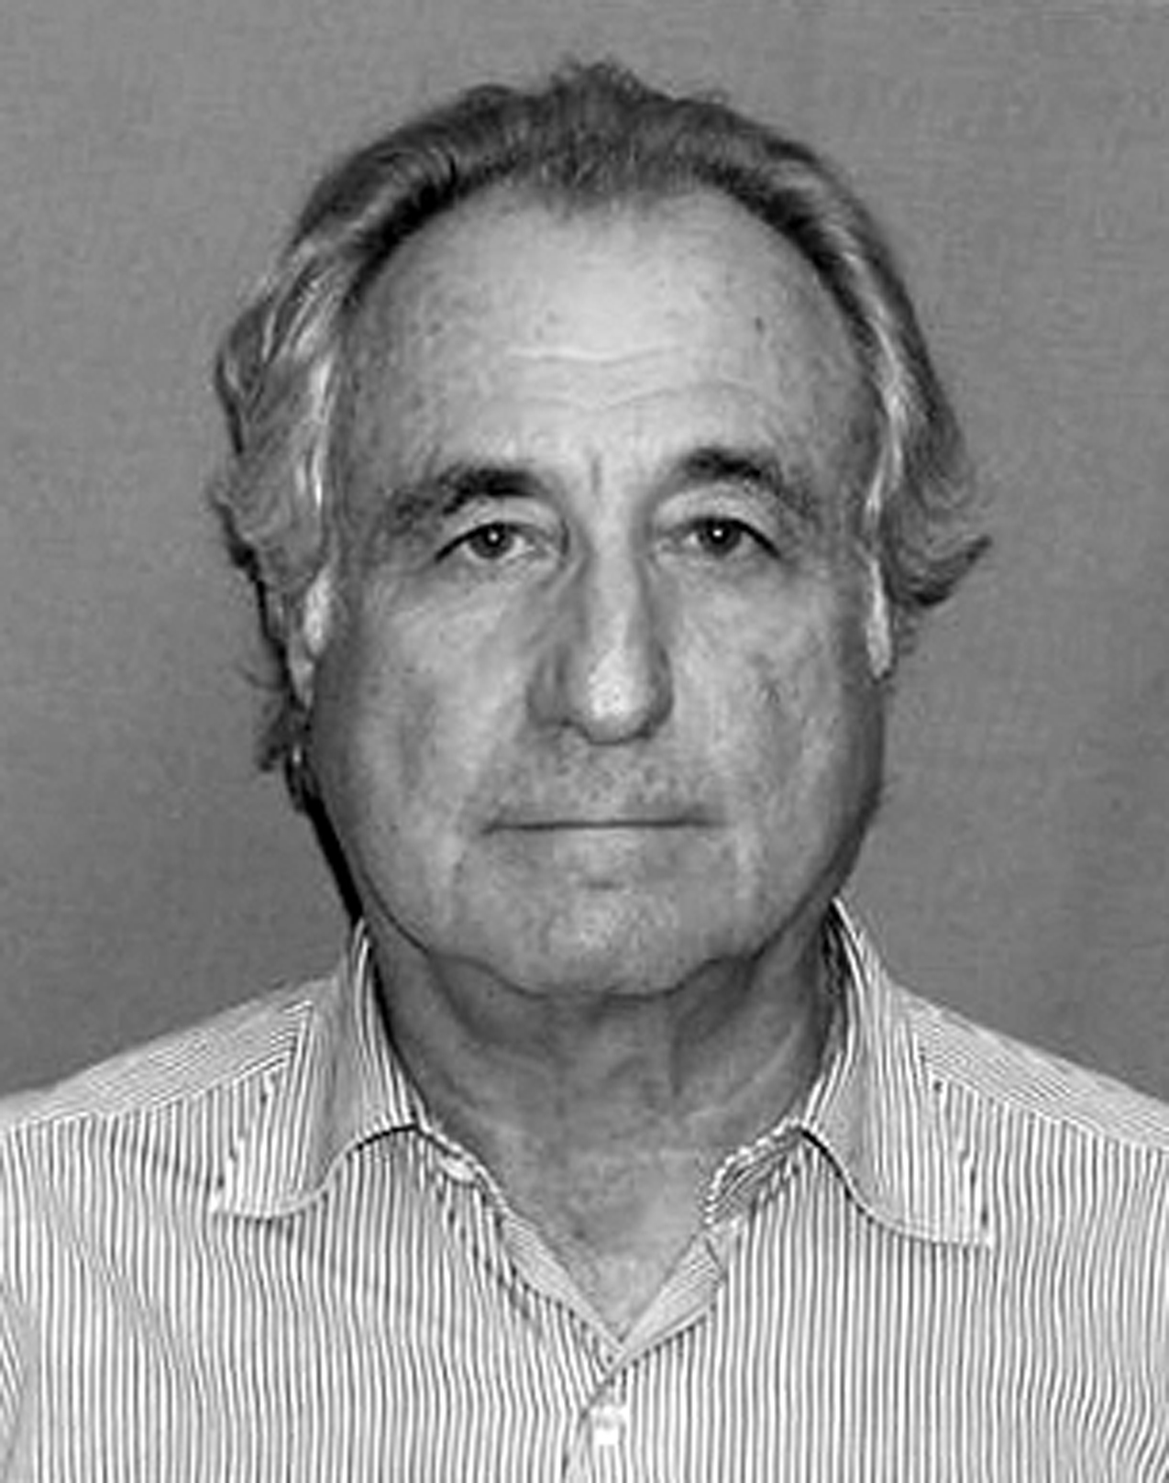
History’s Largest Ponzi Scheme
Slide 15.5
Lesson 15 – The Role of Government in Financial Markets
Operated by New Yorker Bernard Madoff, 1991-2008.
Investor losses estimated at $65 billion.
The scheme was based on no real assets or investments; it paid early investors with money from later investors.
The scheme, clearly with SEC jurisdiction, went undetected by the SEC:
SEC was repeatedly tipped off
Multiple examinations and investigations
Yet fraud went undetected
Bernard Madoff

Slide 7
Pay Your Money, Take Your Chances
Slide 15.6
Lesson 15 – The Role of Government in Financial Markets
Investing in stocks: potential for high returns, but with risk
Some investors’ losses arise from ordinary business risk
No government agency can remove this risk
When fully informed investors lose money because of business results:
there is no market failure
there is no government failure

Slide 8
A Classification Game
Slide 15.7
Lesson 15 – The Role of Government in Financial Markets
Indicate your answer:
Move to that side of the classroom for “market failure.”
Move to that side of the classroom for “government failure.”
Stand in place if there is no market failure and no government failure.

Slide 9
Pay Package Snag
Slide 15.8
Lesson 15 – The Role of Government in Financial Markets
Investment fund managers take on excessive risk because their pay packages reward them for high returns, but provide no penalty for losing shareholders’ money. The fund’s disclosures meet the letter of the law but they understate the risk.
Market failure No failure, stand in place Government failure

Slide 10
Grocery Startup
Slide 15.9
Lesson 15 – The Role of Government in Financial Markets
Webvan.com pioneers the online grocery business, grows too fast, and fails. Although there is no fraud, because of the business risk investors lose all the money they put into it.
Market failure No failure, stand in place Government failure

Slide 11
Home-loan Mess
Slide 15.10
Lesson 15 – The Role of Government in Financial Markets
Government housing policy requires risky loans to less qualified customers, and many of the new homeowners are then unable to make their payments. Financial distress spreads and the housing market crashes.
Market failure No failure, stand in place Government failure

Slide 12
AOL-Time Warner
Slide 15.11
Lesson 15 – The Role of Government in Financial Markets
After full disclosures and despite high hopes, a merger of media giant Time Warner with Internet startup AOL loses billions of dollars of investor money.
Market failure No failure, stand in place Government failure

Slide 13
Senior Sales Push
Slide 15.12
Lesson 15 – The Role of Government in Financial Markets
A high-pressure phone bank sells stocks over the phone to uninformed residents of nursing homes. Although investigators can find no violations of law, it is clear that the buyers did not understand the risks.
Market failure No failure, stand in place Government failure

Slide 14
Your Results May Vary
Slide 15.13
Lesson 15 – The Role of Government in Financial Markets
After becoming fully informed about the risks and returns of holding stocks for the long term, an individual investor finds that stocks have gone down overall for a ten-year period.
Market failure No failure, stand in place Government failure

Slide 15
Two Kinds of Risk
Slide 15.14
Lesson 15 – The Role of Government in Financial Markets
Security-specific risk: the risk that any one stock or bond might fail.
Systemic risk: the risk that the entire system could fail because of interconnections among bankers, brokerages, and other financial institutions.

Slide 16
Why You’re Responsible
Slide 15.15
Lesson 15 – The Role of Government in Financial Markets
Government regulation aims mainly at disclosure and fair dealing, but it cannot guarantee a return on investments.
Criminals operating fraudulent investment schemes will claim to be safe, registered, and licensed.
Even when regulation is adequate to handle security-specific risk, systemic risk may occur.

