Slide 1
Building Wealth over the Long Term
Lesson 9

Slide 2
Three Rules for Building Wealth
Slide 9.1
Lesson 9 – Building Wealth over the Long Term
Start early.
Give money time to grow.
Buy and hold.
Keep your money invested.
Diversify.
Don’t put all your eggs in one basket.

Slide 3
Charlayne Becomes a Millionaire - Accidentally
Slide 9.2
Lesson 9 – Building Wealth over the Long Term
Year | Beginning Balance | Addition to Principal | Return | Ending Balance
0 | $0.00 | $2,600.00 | $104.00 | $2,704.00
1 | $2,704.00 | $2,600.00 | $320.32 | $5,624.32
2 | $5,624.32 | $2,600.00 | $553.95 | $8,778.27
3 | $8,778.27 | $2,600.00 | $806.26 | $12,184.53
4 | $12,184.53 | $2,600.00 | $1,078.76 | $15,863.29
5 | $15,863.29 | $2,600.00 | $1,373.06 | $19,836.35
6 | $19,836.35 | $2,600.00 | $1,690.91 | $24,127.26
7 | $24,127.26 | $2,600.00 | $2,034.18 | $28,761.44
8 | $28,761.44 | $2,600.00 | $2,404.92 | $33,766.36
9 | $33,766.36 | $2,600.00 | $2,805.31 | $39,171.66
10 | $39,171.66 | $2,600.00 | $3,237.73 | $45,009.40

Slide 4
Charlayne Becomes a Millionaire – Accidentally (Cont.)
Slide 9.3
Lesson 9 – Building Wealth over the Long Term
Year | Beginning Balance | Addition to Principal | Return | Ending Balance
11 | $45,009.40 | $2,600.00 | $3,704.75 | $51,314.15
12 | $51,314.15 | $2,600.00 | $4,209.13 | $58,123.28
13 | $58,123.28 | $2,600.00 | $4,753.86 | $65,477.14
14 | $65,477.14 | $2,600.00 | $5,342.17 | $73,419.32
15 | $73,419.32 | $2,600.00 | $5,977.55 | $81,996.86
16 | $81,996.86 | $2,600.00 | $6,663.75 | $91,260.61
17 | $91,260.61 | $2,600.00 | $7,404.85 | $101,265.46
18 | $101,265.46 | $2,600.00 | $8,205.24 | $112,070.70
19 | $112,070.70 | $2,600.00 | $9,069.66 | $123,740.35
20 | $123,740.35 | $2,600.00 | $10,003.23 | $136,343.58
21 | $136,343,58 | $2,600.00 | $11,011.49 | $149,955.07
22 | $149,955.07 | $2,600.00 | $12,100.41 | $164,655.47
23 | $164,655.47 | $2,600.00 | $13,276.44 | $180,531.91

Slide 5
Charlayne Becomes a Millionaire – Accidentally (Cont.)
Slide 9.4
Lesson 9 – Building Wealth over the Long Term
Year | Beginning Balance | Addition to Principal | Return | Ending Balance
24 | $180,531.91 | $2,600.00 | $14,546.55 | $197,678.46
25 | $197,678.46 | $2,600.00 | $15,918.28 | $216,196.74
26 | $216,196.74 | $2,600.00 | $17,399.74 | $236,196.48
27 | $236,196.48 | $2,600.00 | $18,999.72 | $257,796.20
28 | $257,796.20 | $2,600.00 | $20,727.70 | $281,123.89
29 | $281,123.89 | $2,600.00 | $22,593.91 | $306,317.80
30 | $306,317.80 | $2,600.00 | $24,609.42 | $333,527.23
31 | $333,527.23 | $2,600.00 | $26,786.18 | $362,913.41
32 | $362,913.41 | $2,600.00 | $29,137.07 | $394,650.48
33 | $394,650.48 | $2,600.00 | $31,676.04 | $428,926.52
34 | $428,926.52 | $2,600.00 | $34,418.12 | $465,944,64
35 | $465,944.64 | $2,600.00 | $37,379.57 | $505,924.21
36 | $505,924.21 | $2,600.00 | $40,577.94 | $549,102.14

Slide 6
Charlayne Becomes a Millionaire – Accidentally (Cont.)
Slide 9.5
Lesson 9 – Building Wealth over the Long Term
Year | Beginning Balance | Addition to Principal | Return | Ending Balance
37 | $549,102.14 | $2,600.00 | $44,032.17 | $595,734.32
38 | $595,734.32 | $2,600.00 | $47,762.75 | $646,097.06
39 | $646,097.06 | $2,600.00 | $51,791.76 | $700,488.83
40 | $700,488.83 | $2,600.00 | $56,143.11 | $759,231.93
41 | $759,231.93 | $2,600.00 | $60,842.55 | $822,674.49
42 | $822,674.49 | $2,600.00 | $65,917.96 | $891,192.45
43 | $891,192.45 | $2,600.00 | $71,399.40 | $965,191.84
44 | $965,191.84 | $2,600.00 | $77,319.35 | $1,045,111.19
45 | $1,045,111.19 | $2,600.00 | $83,712.90 | $1,131,424.08

Slide 7
The Magic of Compounding
Slide 9.6
Lesson 9 – Building Wealth over the Long Term
When you save, you earn interest.
When you take the interest out and spend it, it stops growing.
But if you leave the interest in your account so it can grow, you start to earn interest on the interest you earned previously.
Interest on interest is money you didn’t work for. It is money your money makes for you!
Over time, interest on interest can increase your total savings greatly.

Slide 8
Marcus’s Mistake
Slide 9.7
Lesson 9 – Building Wealth over the Long Term
Year | Beginning Balance | Addition to Principal | Return | Ending Balance
0 | $0.00 |  | $0.00 | $0.00
1 | $0.00 |  | $0.00 | $0.00
2 | $0.00 |  | $0.00 | $0.00
3 | $0.00 |  | $0.00 | $0.00
4 | $0.00 |  | $0.00 | $0.00
5 | $0.00 |  | $0.00 | $0.00
6 | $0.00 |  | $0.00 | $0.00
7 | $0.00 |  | $0.00 | $0.00
8 | $0.00 |  | $0.00 | $0.00
9 | $0.00 |  | $0.00 | $0.00
10 | $0.00 | $2,600.00 | $104.00 | $2,704.00

Slide 9
Marcus’s Mistake (Cont.)
Slide 9.8
Lesson 9 – Building Wealth over the Long Term
Year | Beginning Balance | Addition to Principal | Return | Ending Balance
11 | $2,704.00 | $2,600.00 | $320.32 | $5,624.32
12 | $5,624.32 | $2,600.00 | $553.95 | $8,778.27
13 | $8,778.27 | $2,600.00 | $806.26 | $12,184.53
14 | $12,184.53 | $2,600.00 | $1,078.76 | $15,863.29
15 | $15,863.29 | $2,600.00 | $1,373.06 | $19,836.35
16 | $19,836.35 | $2,600.00 | $1,690.91 | $24,127.26
17 | $24,127.26 | $2,600.00 | $2,034.18 | $28,761.44
18 | $28,761.44 | $2,600.00 | $2,404.92 | $33,766.36
19 | $33,766.36 | $2,600.00 | $2,805.31 | $39,171.66
20 | $39,171.66 | $2,600.00 | $3,237.73 | $45,009.40
21 | $45,009.40 | $2,600.00 | $3,704.75 | $51,314.15
22 | $51,314.15 | $2,600.00 | $4,209.13 | $58,123.28
23 | $58,123.28 | $2,600.00 | $4,753.86 | $65,477.14

Slide 10
Marcus’s Mistake (Cont.)
Slide 9.9
Lesson 9 – Building Wealth over the Long Term
Year | Beginning Balance | Addition to Principal | Return | Ending Balance
24 | $65,477.14 | $2,600.00 | $5,342.17 | $73,419.32
25 | $73,419.32 | $2,600.00 | $5,977.55 | $81,996.86
26 | $81,996.86 | $2,600.00 | $6,663.75 | $91,260.61
27 | $91,260.61 | $2,600.00 | $7,404.85 | $101,265.46
28 | $101,265.46 | $2,600.00 | $8,205.24 | $112,070.70
29 | $112,070.70 | $2,600.00 | $9,069.66 | $123,740.35
30 | $123,740.35 | $2,600.00 | $10,003.23 | $136,343.58
31 | $136,343,58 | $2,600.00 | $11,011.49 | $149,955.07
32 | $149,955.07 | $2,600.00 | $12,100.41 | $164,655.47
33 | $164,655.47 | $2,600.00 | $13,276.44 | $180,531.91
34 | $180,531.91 | $2,600.00 | $14,546.55 | $197,678.46
35 | $197,678.46 | $2,600.00 | $15,918.28 | $216,196.74
36 | $216,196.74 | $2,600.00 | $17,399.74 | $236,196.48

Slide 11
Marcus’s Mistake (Cont.)
Slide 9.10
Lesson 9 – Building Wealth over the Long Term
Year | Beginning Balance | Addition to Principal | Return | Ending Balance
37 | $236,196.48 | $2,600.00 | $18,999.72 | $257,796.20
38 | $257,796.20 | $2,600.00 | $20,727.70 | $281,123.89
39 | $281,123.89 | $2,600.00 | $22,593.91 | $306,317.80
40 | $306,317.80 | $2,600.00 | $24,609.42 | $333,527.23
41 | $333,527.23 | $2,600.00 | $26,786.18 | $362,913.41
42 | $362,913.41 | $2,600.00 | $29,137.07 | $394,650.48
43 | $394,650.48 | $2,600.00 | $31,676.04 | $428,926.52
44 | $428,926.52 | $2,600.00 | $34,418.12 | $465,944,64
45 | $465,944.64 | $2,600.00 | $37,379.57 | $505,924.21

Slide 12
Buy and Hold
Slide 9.11
Lesson 9 – Building Wealth over the Long Term
In order to leave money in savings or investments, you have to do these things:
Spend less than you receive. How?
Perhaps you could …
Earn more by improving your formal education or job skills.
Spend less by using a budget to keep track of where your money is going.
Become connected to financial institutions. How?
Open and maintain accounts at mainstream financial institutions – banks, credit unions, and brokerages.
Manage your credit responsibly. How?
Limit the number of credit cards you have.
Limit your purchases to amounts you can pay off each month.
Apply for loans when you are confident that your current income (in the case of college loans, future income) will allow you to repay the loan.

Slide 13
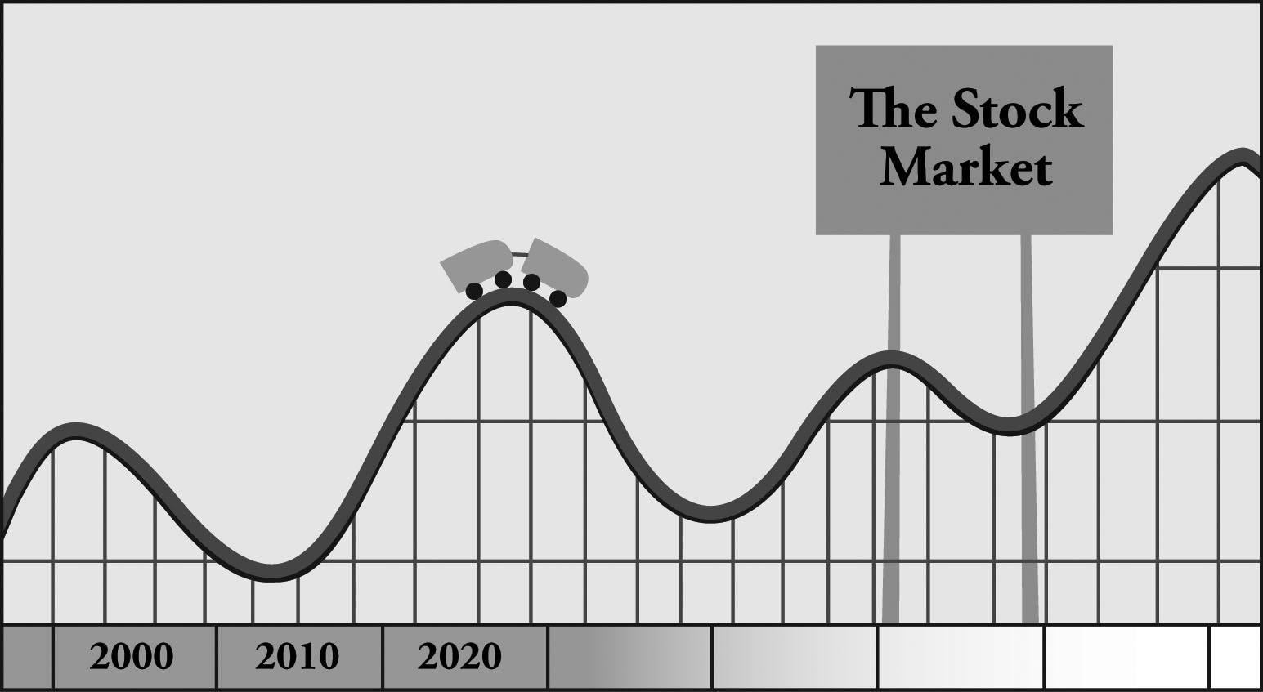
The Stock Market Roller Coaster
Slide 9.12
Lesson 9 – Building Wealth over the Long Term
If you buy and sell on the ups and downs, you may lose money.
Those who have held stocks for the long term have found the ups are greater than the downs.

Slide 14
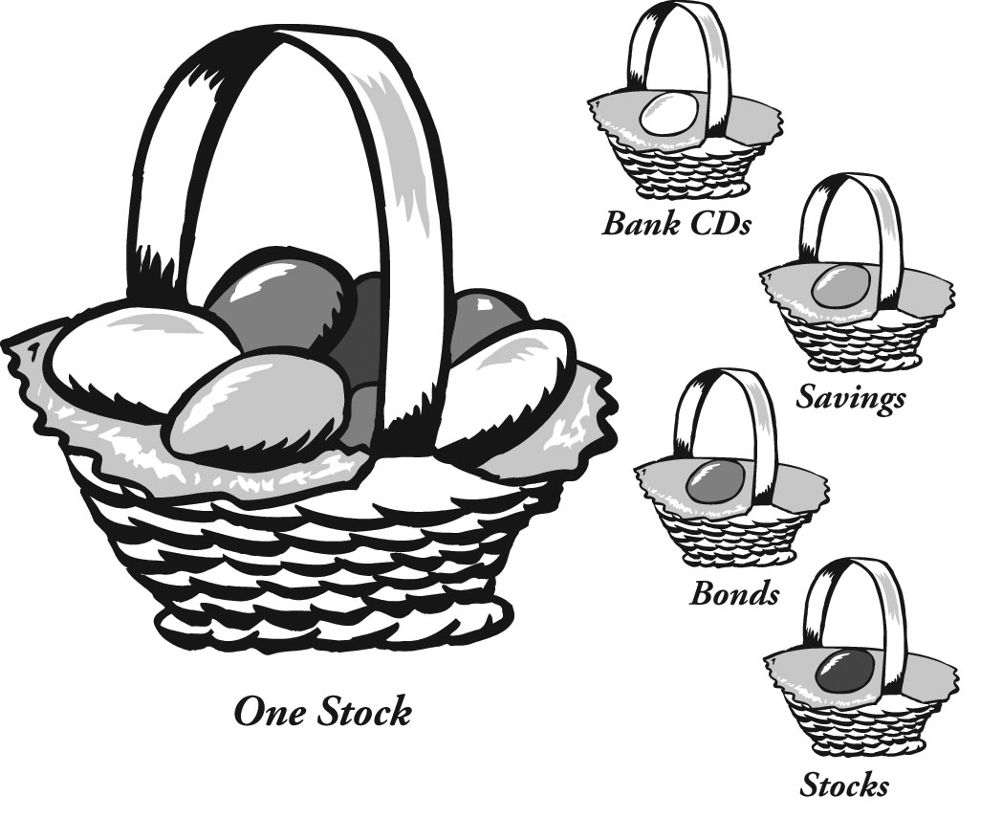
Don’t Put All Your Eggs in One Basket
Slide 9.13
Lesson 9 – Building Wealth over the Long Term
With your money spread out across a variety of assets (stocks, bonds, and cash, for example), you’re not hurt badly when any one asset does poorly.

Slide 15
Forms of Saving and Investing: Some Benefits and Costs
Slide 9.14
Lesson 9 – Building Wealth over the Long Term
Savings accounts: provide a small but steady return.
Certificates of deposit: very safe, but instant access carries a penalty.
Bonds: lending money to a corporation or government, with a promise of higher returns that those offered by bank savings accounts and CDs.
Stocks: part ownership in a company, offering higher risks and, potentially, higher returns than some other investments.
Real estate: the risks and benefits of being a landlord.

Slide 16
Investment Situations
Slide 9.15
Lesson 9 – Building Wealth over the Long Term
You have $5,000 to invest. No other information is available.
You have $4,000 that you’ll need six months from now.
You inherited $10,000 from your great-aunt; she has suggested that you save it for use in your old age.
You are just starting a career and can save $50 per month for retirement.
A new baby arrives, and Mom and Dad plan to save $100 a month for the child’s college education.

Slide 17
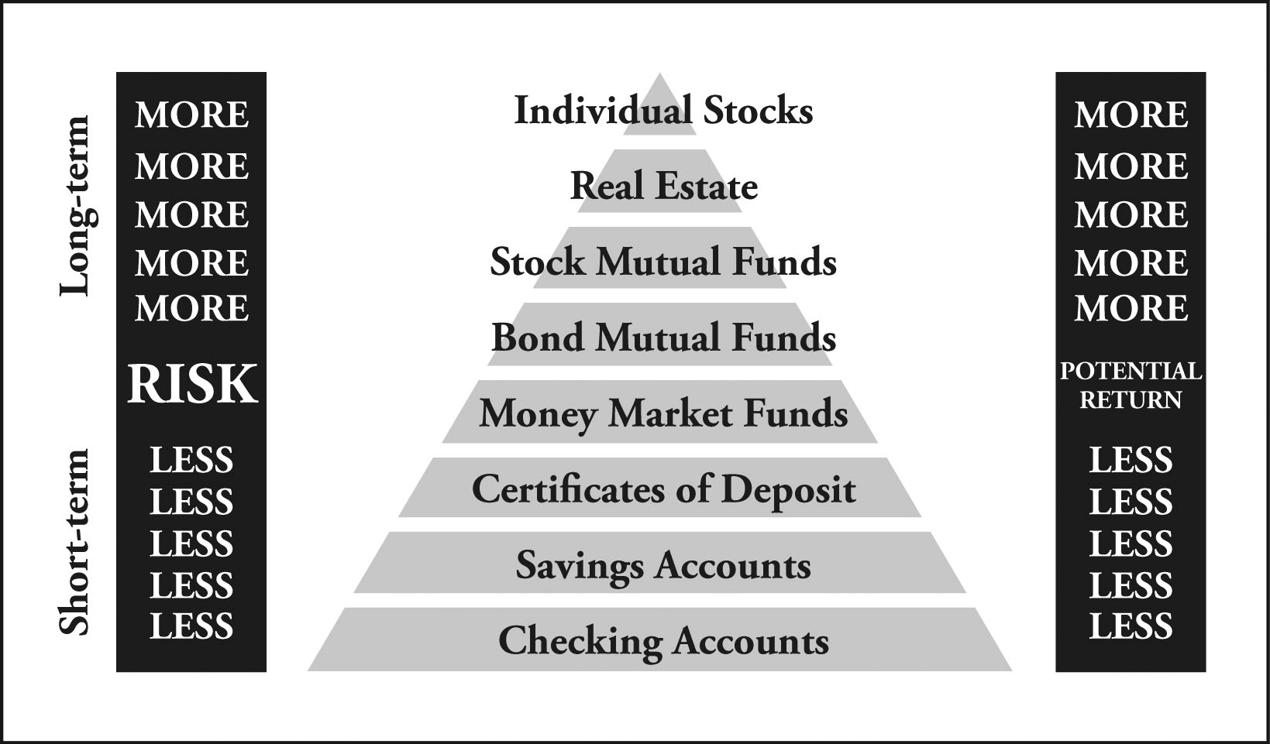
The Pyramid of Risk and Return
Slide 9.16
Lesson 9 – Building Wealth over the Long Term

Slide 18
Mutual Funds
Slide 9.17
Lesson 9 – Building Wealth over the Long Term
A mutual fund pools investor’s money.
The fund puts its investors’ money into the markets on their behalf.
In effect, investors own small amounts of many different assets.
Mutual funds enable investors to avoid the risk that comes from owning any one asset. In other words, mutual funds make it easy to diversify.

Slide 19
Floor Marker 1
Lesson 9 – Building Wealth over the Long Term
Savings
Account

Slide 20
Floor Marker 2
Lesson 9 – Building Wealth over the Long Term
Certificate
Of Deposit

Slide 21
Floor Marker 3
Lesson 9 – Building Wealth over the Long Term
Bonds

Slide 22
Floor Marker 4
Lesson 9 – Building Wealth over the Long Term
Stocks

Slide 23
Floor Marker 5
Lesson 9 – Building Wealth over the Long Term
Real Estate

